Slide 1
Infinite Width NN
Shangyang Min, Zhilong Feng

Slide 2
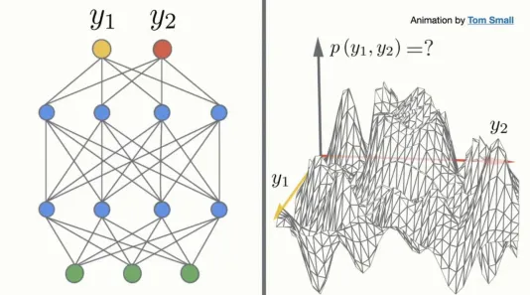
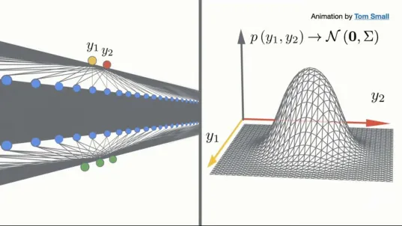
Infinite Width NN
VS

Slide 3
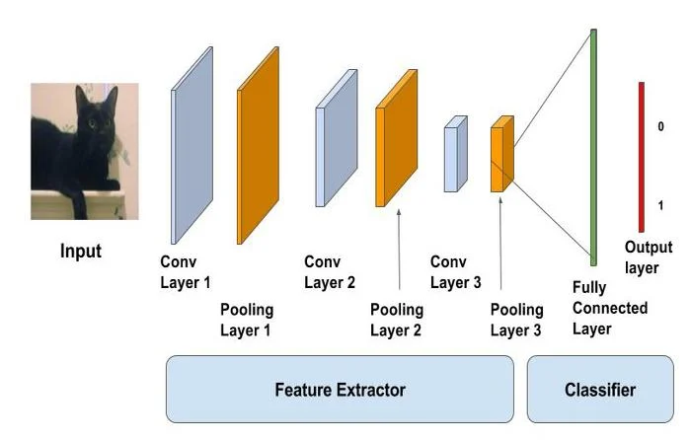
Project Goal
Perform an image classification task
Build Models based on Infinite Width NN
Compare the performance with the normal approach - Finite CNN

Slide 4

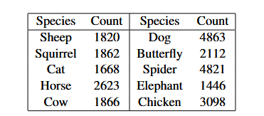
Dataset
Animals-10

Slide 5
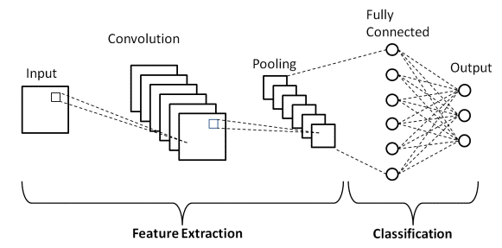
Baseline CNN

Slide 6
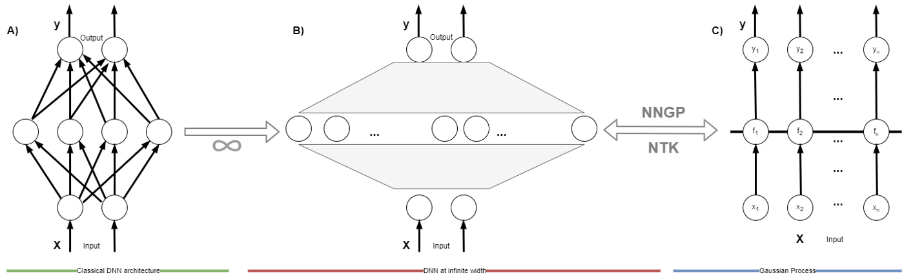
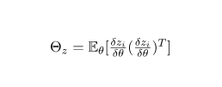

Types of Infinite NN
NNGP Kernel
NTK Kernel
Bayesian infinite neural network
gradient descent trained infinite network

Slide 7
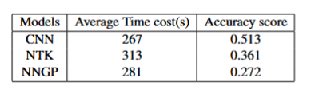
Experiment I
Set up environment
Get familiar with the library
Addressing problems we face and finding solutions for Experiment II
Build models with the similar power
Simple comparison without testing factors that may have influenced the result

Slide 8
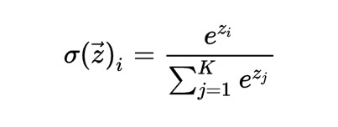
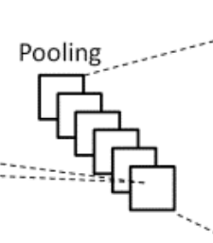
Downside of Infinite NN
Lack of Ability to use Softmax
Lack of Ability to Pool:
No Maxpool support
Avg pool resource issue
Solution: To count the label with the highest probability

Slide 9
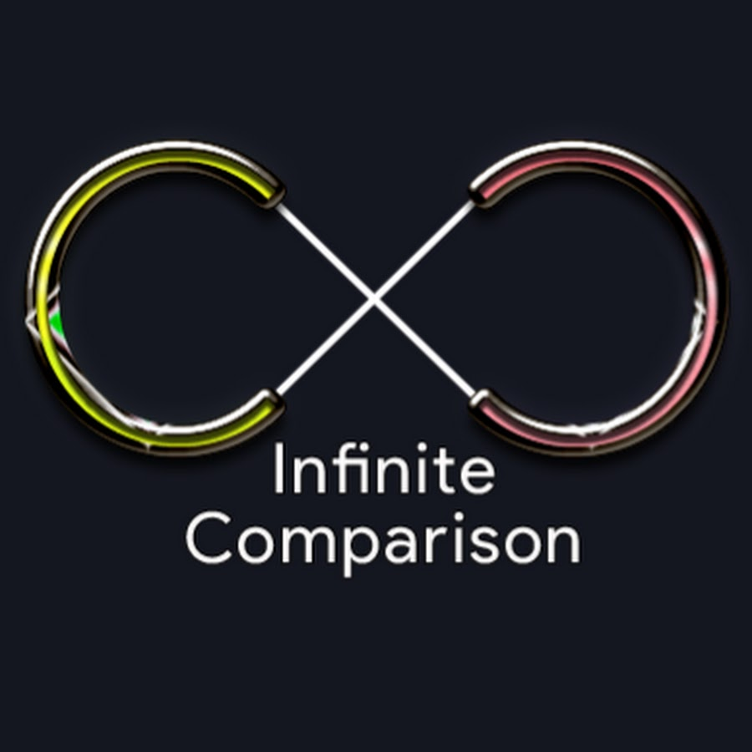
Experiment II
Focus on comparison
Addressing factors(problems we faced in Exp I) may influence the results:
Capacity
Batches
Sample Size
Image Resolution
Down Sampling

Slide 10
Experiment II
Capacity Issue
Our code runs in October, but does not work in November :)
Library capacity with CUDA
Solutions on system env variable all failed
MSU HPCC upgrade in October
Locked CUDA version to 11.5.0
Pay Google to access the training power in Colab
Experiment I result is based on V100
Experiment II result based on Colab, higher training power, less GPU memory (Reason we change our training strategy)

Slide 11
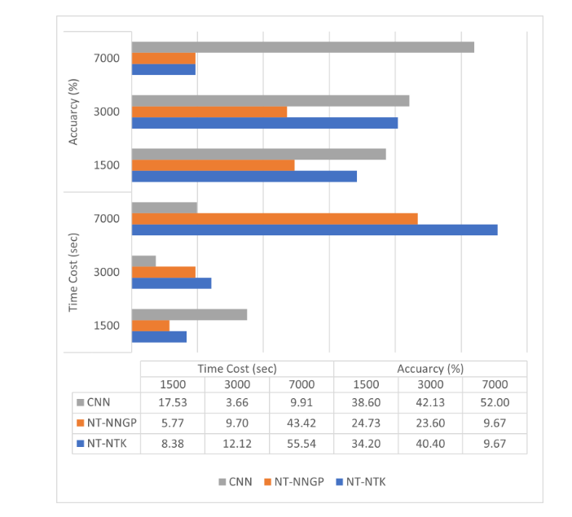
Experiment II
Training Size Issue
Increase while training samples increase
Will overfit if the dataset goes large
Shuffle and cut the training set to 3000

Slide 12
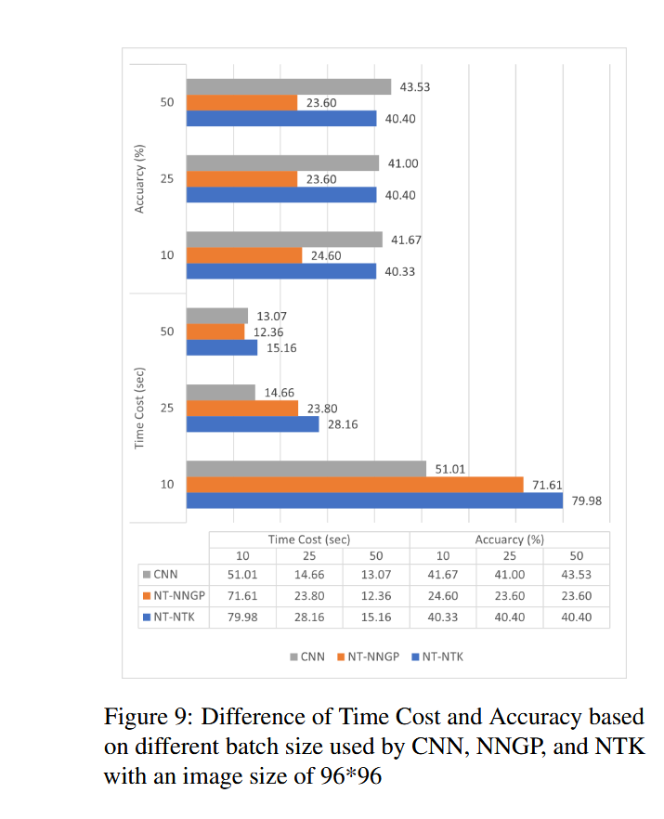
Experiment II
Batch Size
Ideally, the GPUs can read all the training data, but it requires 100TB+ GPU memory
We found out a method to break down the training data and use batches
Limited Resource, we are not google :(
No significant influence on output, only in training time

Slide 13
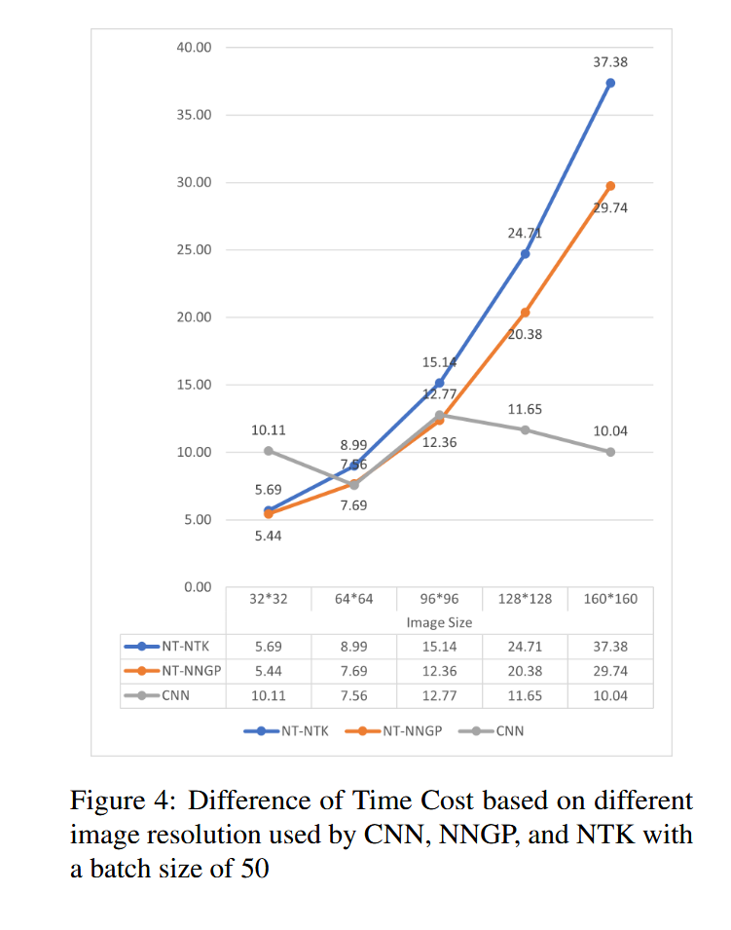
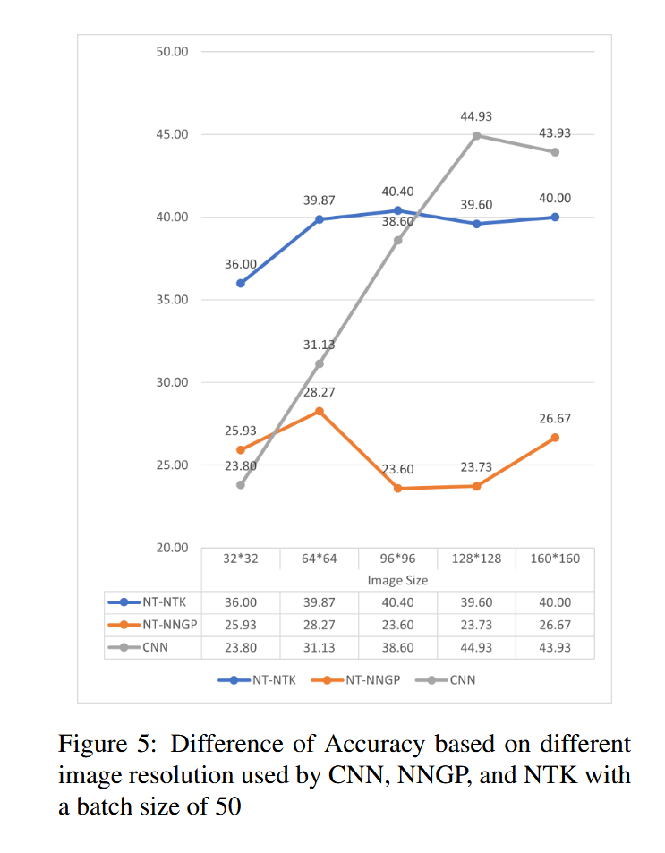
Experiment II
Image Resolution Resize
Baseline CNN will not be influenced by the resolution of the image
Infinite width NNs linearly increase its training time
The accuracy in CNN will increase as the image resolution goes higher but Infinite width NNs do not

Slide 14
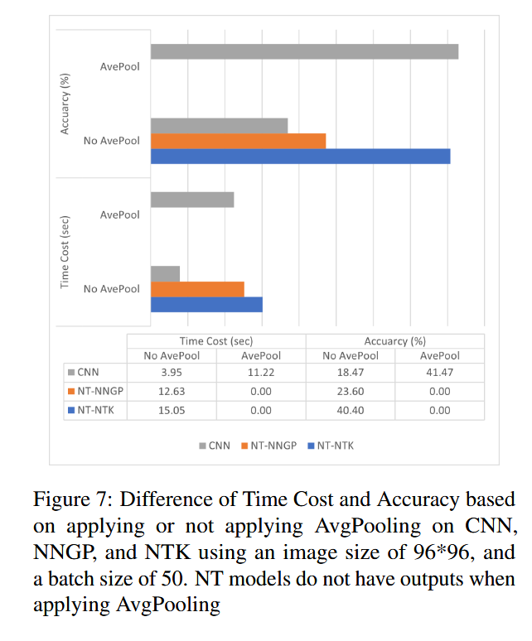
Experiment II
DownSampling
We found out that no Maxpool support
Using Avgpool instead
Infinite Width NN ran for 30+ minutes then the kernel died! (Memory Issue)

Slide 15
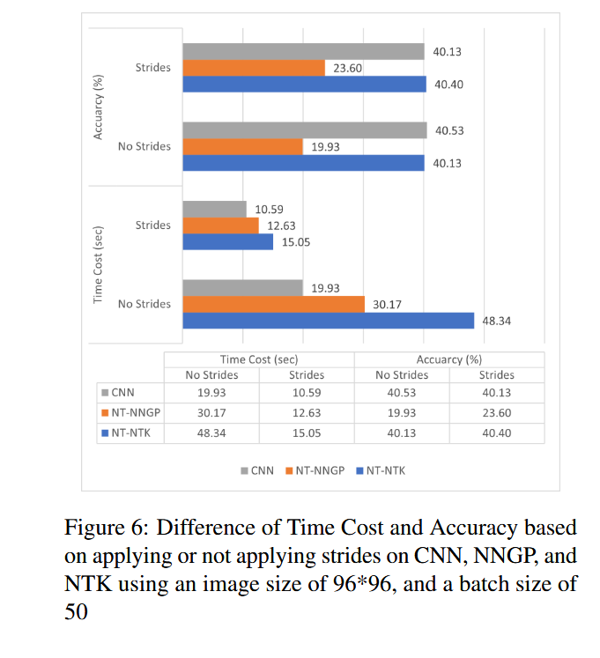
Experiment II
DownSampling
We also applied strides = 2 as a solution for downsampling without pooling in the 3 models
Decrease in time
No significant increase in Accuracy

Slide 16
Final Result
Generally, we agree Infinite width NN is a great theory to explore more
Limitations: library, resources
Outperformed by the traditional CNN in image tasks
May have better performance in other fields of study like signal processing, NLP, etc.
Conclusion: Should not be applied in real tasks at this stage.

Slide 17


